Slide 1
ICT Usage and Literacy in Sri Lanka
Survey - National Survey on ICT Access and Usage by Households and Individuals 2017
By ICTA (Information and Communication technology Agency of Sri Lanka)
Group 1 – Data Science Group Project
Group Members
Perera K.A.H.P
D.A.D.N.P De Silva
Chathuranga N.A.H.W.S
W.A.D.N.S Wijesuriya

Slide 2
Introduction
ICT literacy is using digital technology, communications tools, and/or networks to access, manage, integrate, evaluate, and create information in order to function in a knowledge society.
A person (aged 5-69) is considered as a computer literate person if he/she could use computer on his/her own.
Computer Literate population expressed as a percentage to the total population, within the respective domain.

Slide 3
Objectives
Presented analysis is done to take an overall idea of the present ICT literacy distribution.
The goal is to identify specific segments that government should address in order to improve ICT development in Sri Lanka.
Efficient Information provided at the right time, is very important to guide the government effort in right direction and to take necessary actions.
This can also be contributed to study demand patterns for internet providers and progress the ICT development.

Slide 4
Preparation of the Dataset
Survey - National Survey on ICT Access and Usage by Households and Individuals 2017 By ICTA (Information and Communication technology Agency of Sri Lanka)
Sample – 8941 Households from all 25 districts. Sample of more than 300 Households from one district.
Individual Usage Data – 30,239 Individuals from 8,941 Households.
Analysis were done according to following feature categories
User Profiling features
ICT usage and literacy features

Slide 5
User Profiling
Demographics
Sex
Marital Status
Level of Education
Age
Employment Status
Employment Type
Geographic
District
Province
Location Urban/Rural/Estate Categorization

Slide 6
ICT Usage features
ICT Usage
Number of Desktop/Lap Top/ Tablet Devices -3.1
Number of Smart Phones (Excluded Conventional Phones but can add after discussion) -3.1
Internet Usage (Yes/No) -3.1
Excluded 3.2 Since content is same as 3.1 only difference is Home vs. Outside
Maximum Frequency of Internet Facilities-3.3
Maximum Frequency of Socially connected Activities. -3.4 -maxSocConnect
Summation of socially connected Activities – sumSocConnect
Total Number of Social Media Facilities used -3.5 – countSocNetwork

Slide 7
ICT Literacy features
ICT Literacy
Total Number of Skills out of 15 Skills. 4.1 – totSkills
Maximum ICT Education Qualification. 4.2 -maxICTLit

Slide 8
Descriptive Analysis

Slide 9
Percentage of computer used Individuals by Sector, Province & District
Northern and Eastern Province have the lowest percentage of individuals who have computer facility. When looking at the district level Trincomalee, Moneragala and Amapara districts are the districts are in the lower computer facility group.

Slide 10
Percentage of Internet Accessible Individuals by Sector, Province & District
Uva and Eastern Province have the lowest percentage of individuals who have internet facility. When looking at the district level Batticaloa, Ampara and Jaffna districts are the districts are in the lower internet facility group.

Slide 11
Percentage of computer used Individuals by Age, Education Level & Employee Types
When looking at the education level Phd/Degree and diploma holders have the computer and internet facilities than other groups. Only 6% of the A/L has the computer facilities and 14% of them have the internet facility.
Migrant Workers and Private Sector employees have computer facilities and internet facilities than other employee segments.
When looking at Age You individuals whose age between Age 20-24 are using the computer and internet facilities most compared to other age groups.

Slide 12
Percentage of Internet Accessible Individuals by Age, Education Level & Employee Types

Slide 13
ICT Literacy Distribution Sri Lanka
73% of the individuals have no ICT literacy and 15% of the individuals who have ICT literacy are also from Informal learning.

Slide 14
ICT Literacy Distribution by Province
Higher percentage of individuals have informal literacy in Western and North Western provinces. Western province have the higher percentage of individuals who learned ICT from school curriculum.

Slide 15
ICT Literacy Distribution by Age
~40% of the individuals in the age group 20-24 & 25-29 have some ICT literacy which significantly higher than other age groups

Slide 16
ICT Literacy Distribution by Education Level
More than 50% of the individuals have some ICT Literacy in Diploma/Degree/MSc/Phd education qualified group. ~25% of the AL students have some ICT Literacy

Slide 17
ICT Literacy Distribution by Employee Type
Privet Sector Employees have high informal ICT Literacy and School Curriculum Literacy compared to other employee categories

Slide 18
Reasons for not availability of facilities
Respondents who respond Facilities are not necessary
Top reason for not availability of Facilities is Equipment cost is too high

Slide 19
Detect and Analyze User Groups According to the ICT literacy and Usage using Segmentation based approach

Slide 20
Variables Used
ICT Usage
1.Desktop/Laptop/Tablet Usage
2. Smart Phone usage
3. Internet usage
4. Social connectivity. (ex. chat Sites, blogging, managing web sites..etc..)
5. Social Media usage (Whatsap,viber, skype, insta….etc)
ICT Literacy
Number of Skills from mentioned 15 skills
Highest ICT Education Level

Slide 21
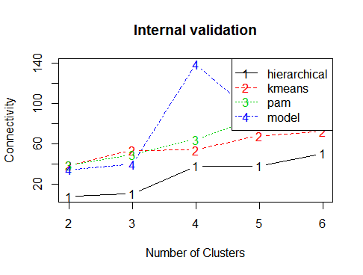
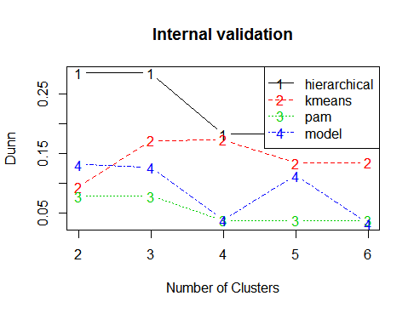
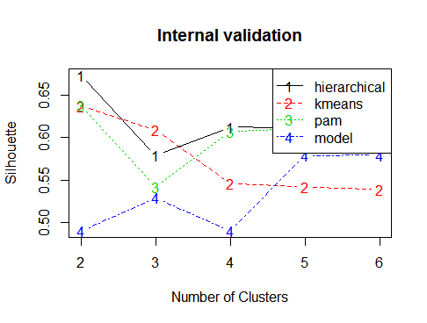
Approach
Cluster analysis using mentioned variables.
Steps :
1. Check data set is able to cluster (Using Hopkins statistics)
Hopkins statistics : 0.1465195
2. Select best Algorithm to cluster (Connectivity, Dunn, Silhouette indexes)

Slide 22
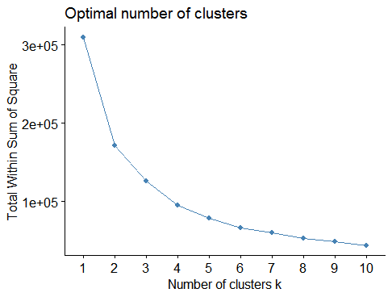
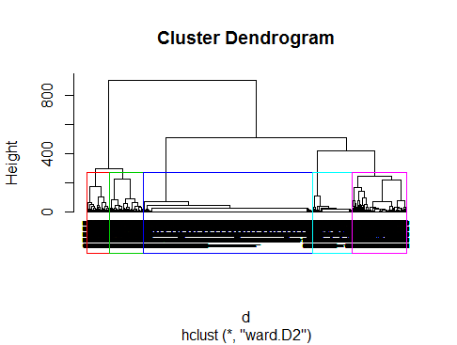
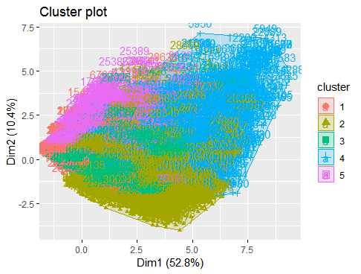
Approach –CNTD
3. Select the number of clusters.
4. Hierarchical clustering Approach

Slide 23
Analyze the Segments
Cluster Distribution Percentage of Individuals by Cluster
Notes:
Cluster 1 have higher number of people compared t the other clusters

Slide 24
Analyze the Segments
Cluster Distribution by Sector
Notes:
Many people in cluster 1 belongs to the rural area while higher number of people in cluster 5 belongs to the urban area

Slide 25
Analyze the Segments
ICT Usage Distribution by Cluster
Notes:
People in cluster 4 and 5 have higher ICT usage compared to the people in Cluster 1 and 2 and 3

Slide 26
Analyze the Segments
ICT Literacy Distribution by Cluster
Notes:
People in cluster 4 and 5 also have high ICT literacy compared to the cluster 1 and 3. But people in cluster 2 also have good ICT literacy even they do not have good ICT usage.

Slide 27
Analyze the Segments
Employment Status by Cluster
Notes:
High percentage of the people in cluster 4 and 5 are employed while unemployed percentage is lower. But unemployed percentage of the cluster 1 ,2,3 is higher compated to the 4 and 5. This may be a reasn for lower ICT usage and Literacy in cluster 1 and 2 people.

Slide 28
Analyze the Segments
Education Level by Cluster
Notes:
Many people in cluster 1 have higher education as the school education while many people in the cluster 5 have certificate level. People in cluster 5 have high higer studies people compared to the other clusters. Also cluster 1 contain no school people.

Slide 29
Analyze the Segments
Cluster Distribution by Provinces
Notes:
Many people in cluster 1 are belongs to the northern ,central and southern provinces,

Slide 30
Analyze the Segments
Reason for not Availability of ICT facility
Notes:
Many people in cluster 1 have higher education as the school education while many people in the cluster 5 have certificate level. People in cluster 5 have high higer studies people compared to the other clusters. Also cluster 1 contain no school people.

Slide 31
Analyze the Segments
Areas to consider when implementing ICT related Activities in Sri Lanka:

Slide 32
Conclusions
People in cluster 1,2 seems to be lower ICT usage compared to the people in cluster 4 and 5
Possible reasons:
1. Higher number of people in Cluster 1 belongs to the rural areas
2. Maximum Education level in cluster 1 is school education.
3. There is higher percentage of unemployed people in cluster 1.
4. Many people in cluster 1 belongs to the Northern, Southern and Central provinces
5. Reason for not availability of ICT facility
Northern province :Facilities are not necessary
Central and southern Provinces : cost of service is too high

Slide 33
THANK YOU

